Slide 1

Mrs. Daniels’ Dance Syllabus and Class Information
Ballet 1, Ballet 2, and
Beginner Men’s Dance
2025-2026

Slide 2
Teacher Contact Info. & Biography
Name: Mrs. Cori Daniels
Email Address: danieco@richmond.k12.ga.us
Courses: Ballet 1, Ballet 2, and Beginning Men’s Dance
Instructional Hours: 8:30-3:25
Cori Daniels has studied the art of ballet since the age of four and began her career as a Dance Educator at Davidson Fine Arts Magnet School in 1998. Mrs. Daniels graduated with honors from the University of Georgia with a Bachelor of Science in Education. She also holds certification in Dance Education for Grades K-12 as well as in Early Childhood Education for Grades P-5.
When she is not in the classroom at Davidson Fine Arts, Mrs. Daniels enjoys being an active member of her church, community theater, and spending time with her husband and three children.
Mrs. Daniels has a passion for education and a heart for young people. She is honored to work with her students and to help each of them grow daily towards their greatest physical, emotional, and artistic potential. Mrs. Daniels is honored to be the 2019-2020 Teacher of the Year for Davidson Fine Arts as well as a Schuler Award Nominee for her Choreography of Davidson's production of "West Side Story”.

Slide 3
Course Descriptions
BALLET 1 COURSE DESCRIPTION
Introduces basic ballet technique and terminology. Covers placement, turn out, body lines, epaulement, adagio, and allegro skills. Stresses aesthetic perception, creative expression and performance, historical and cultural heritage, and aesthetic judgment and criticism.
BALLET 2 COURSE DESCRIPTION
Enhances Ballet 1 skills and terminology. Emphasizes the development and execution of weight placement, alignment, use of rotation, and musicality. Offers opportunities to perform and observe quality dance as an art form.
BEGINNER MEN’S DANCE COURSE DESCRIPTION
Focuses on the specifics of technical and physical expectations of dance with an increased focus on allegro, ballon, and turns. Students are introduced to ballet vocabulary, repertory, variations, conditioning, and athletic enhancement.

Slide 4

Ballet 1, Ballet 2, and Beginner Men's Dance
Dress Code Requirements

Slide 5
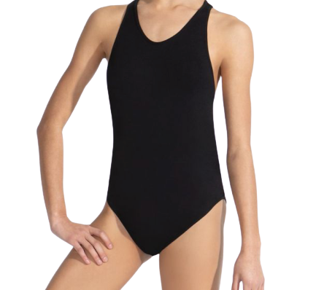
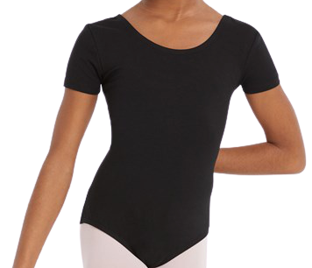
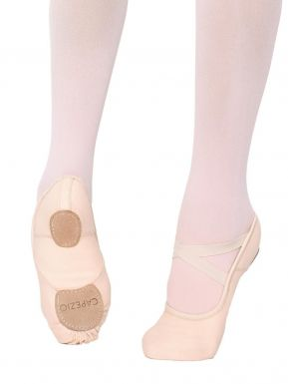
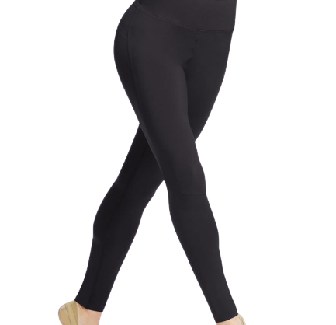
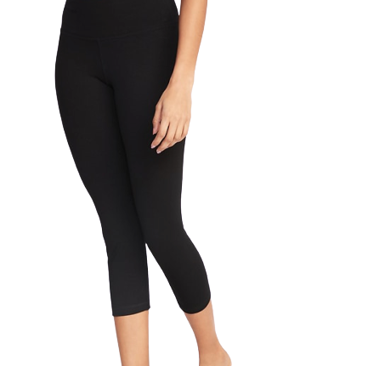
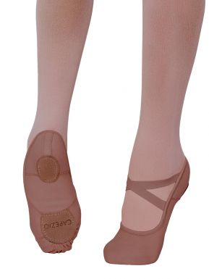
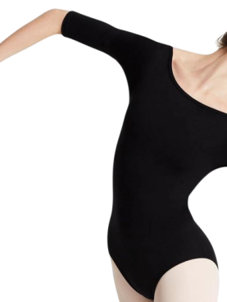
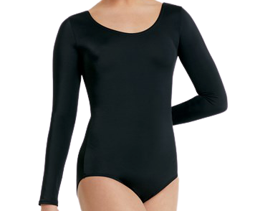
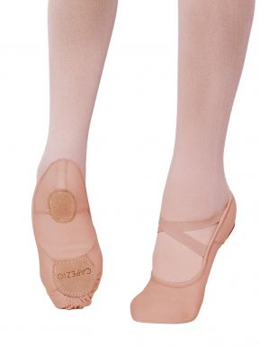
DRESS CODE REQUIREMENTS
for Ballet 1 & Ballet 2 (females)
Grading for wearing attire begins Wednesday, September 3rd
3. Ballet shoes
(leather or canvas, full or split sole are permitted)
Students may choose from traditional “Ballet Pink” or a color that compliments their skin tone. Female students should NOT wear black or white shoes.
1. Solid black leotard
(Any sleeve length except spaghetti straps)
2. SOLID black leggings
(ankle or capri length are fine)
NO mesh, cutouts, or prints and
NO FLARED LEGGINGS
OR

Slide 6
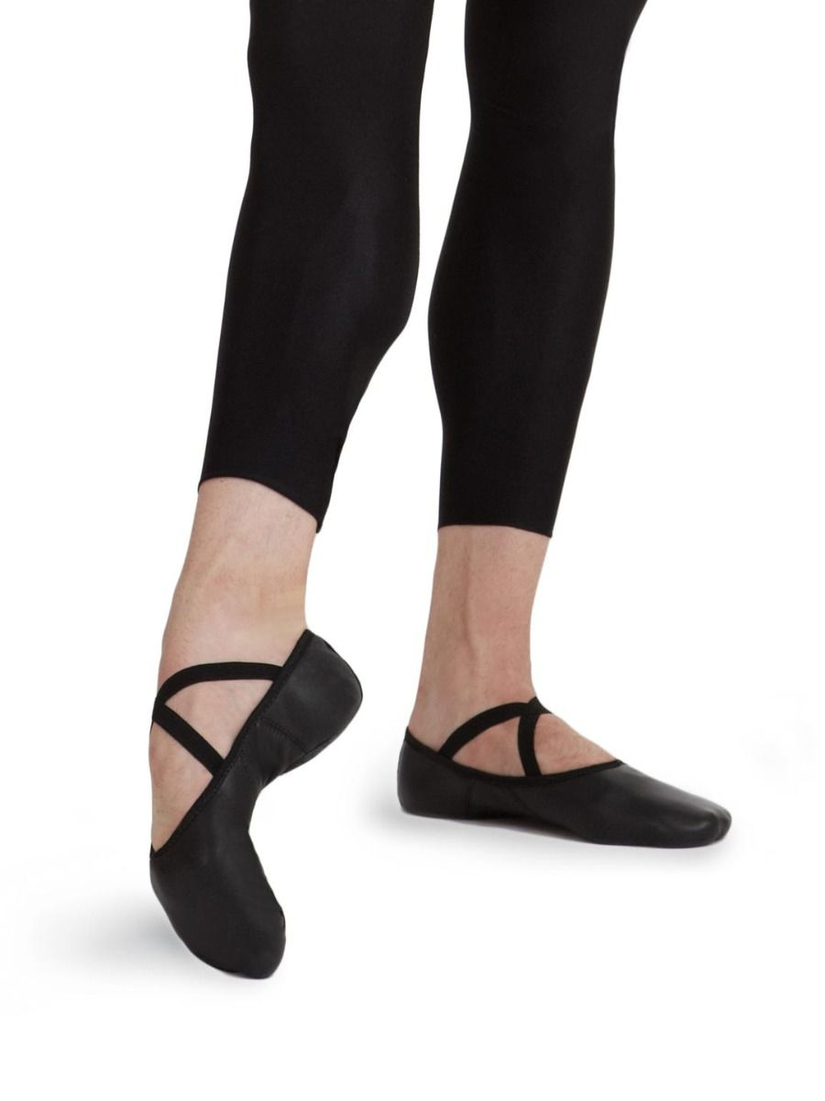

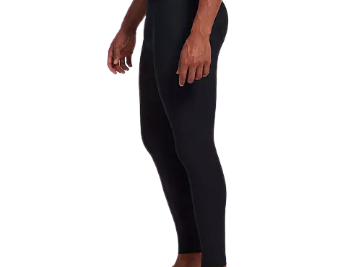
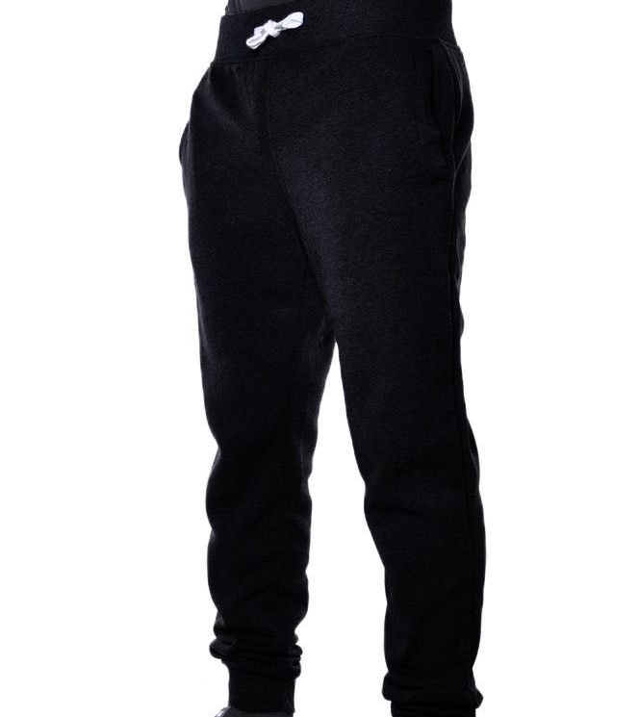
DRESS CODE REQUIREMENTS
for Beginner Men’s Dance & Male Dancers in Ballet 2
Grading for wearing attire begins Wednesday, September 3rd
2. Solid black sweatpants/joggers or compression leggings
(no athletic shorts or jeans)
1. SOLID black t-shirt
(no large logos)
3. Solid black Ballet shoes (leather or canvas)
OR

Slide 7
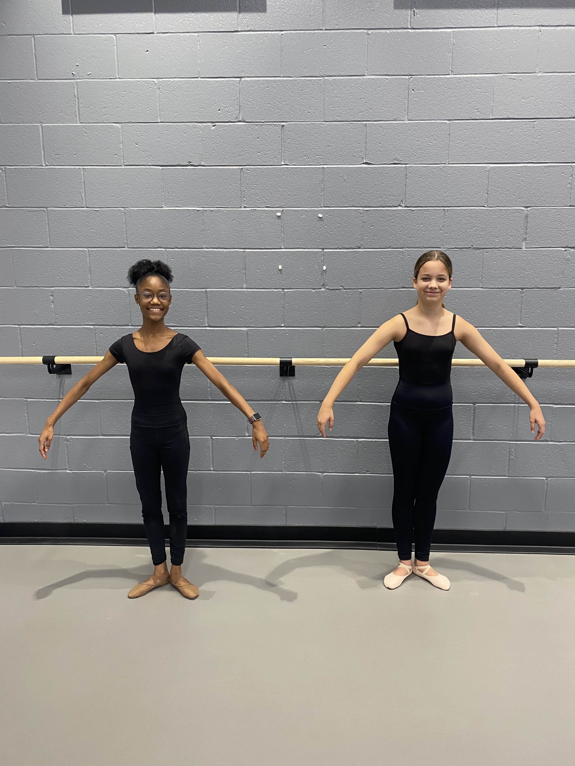
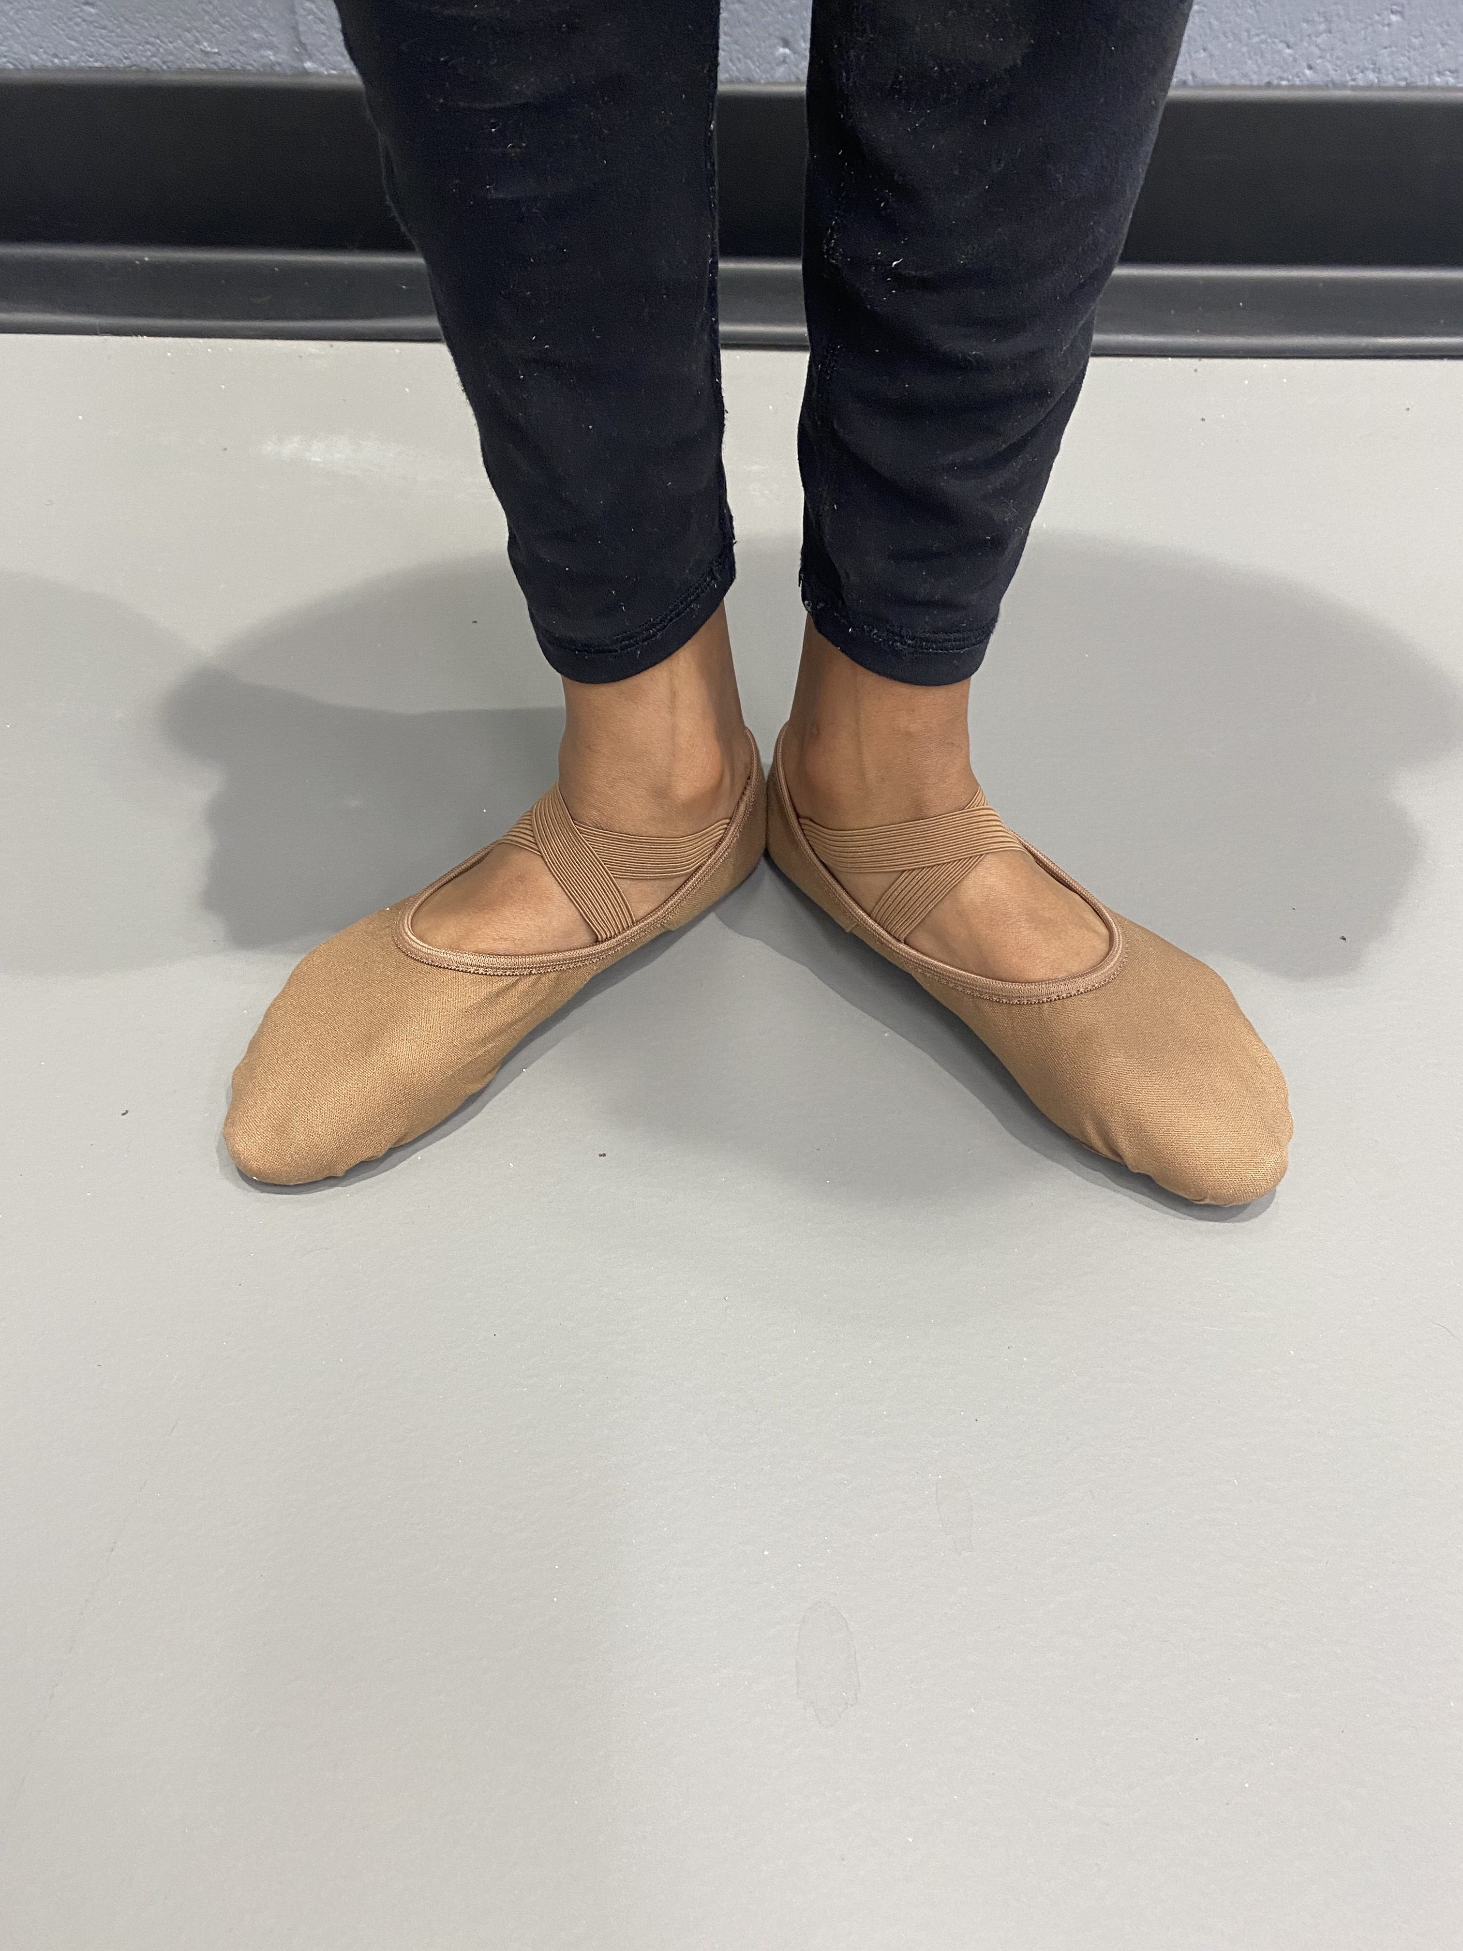
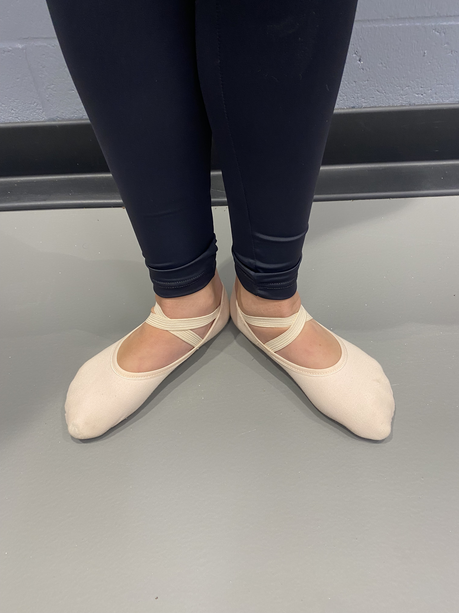

Slide 8
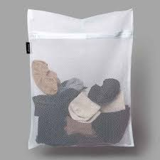
Not required but STRONGLY recommended:
  A “delicates” small laundry bag with zipper.
  Keeps students gear together when transporting from school and home.
  Reduces items being dropped/lost.
  Can be found wherever laundry detergent is sold (Dollar tree, Grocery store, Target, Amazon).

Slide 9
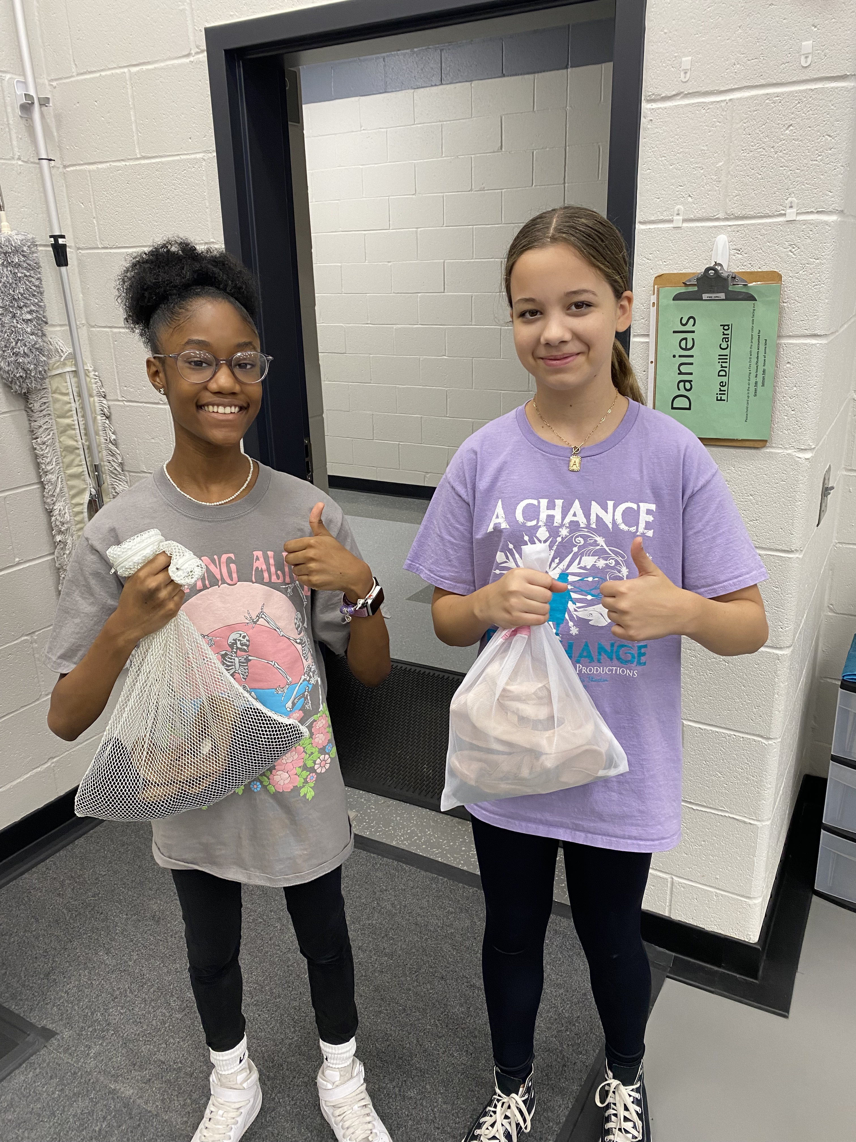
KEEPS DANCE CLOTHES AND SHOES TOGETHER AND ORGANIZED.
FITS INSIDE YOUR BACKPACK AND LOCKER.​
​
HELPS REDUCE LOST ITEMS!​

Slide 10
FURTHER DETAILS
1. Leggings may be any brand. I recommend avoiding designer brand leggings and going as cheap and simple as possible for the leggings.
2. Leotards and Ballet shoes may be purchased locally or online.
3. If your budget allows, it may be helpful to have 2 sets of leggings/leotards (or pants/t-shirts for males) in the event you can't get them laundered over the weekend.
4. Our local dancewear store is "Tutus and Dance Shoes" on Davis Road. They have wonderful customer service, the owner's daughter is a DFA graduate, and many employees are DFA Dance students.
5. Popular online sites include but are not limited to "Discount Dance” and "Dancewear Solutions". If purchasing online please leave time for delivery and for the possibility of returns if the item doesn't fit.
6. Students must wear their dance attire beginning September 3rd. Please email Mrs. Daniels with any questions or concerns (danieco@richmond.k12.ga.us)

Slide 11
Classroom Procedures (PART 1)
1. Proper attire for class is listed this document and should be worn each day beginning Wednesday, September 3rd unless the teacher indicates on the Weekly Schedule on the CANVAS home page that attire is not needed on a specific day. See “Class Expectations” for information on penalty for failure to follow this procedure.
2. Students will use the LOCKER ROOM into their attire and are given an additional 3 minutes at the beginning and end of class to do so. Students WILL NOT be permitted to use stalls in the restroom for changing. Students found changing in the restroom will be given detention.
3. If you forget your clothes, you will be required to participate in class regardless of your attire. No one may sit out simply because they do not have the proper attire for class. Not being dressed out properly will be recorded by the teacher and penalties will apply. In the event of colder weather, students may wear a SOLID BLACK long-sleeved t-shirt, cardigan, or sweatshirt at the discretion of Mrs. Daniels. NO BAGGY OR OVERSIZED ITEMS.
4. Students’ hair should be pulled back away from the face and shoulders for both TECHNIQUE/CONDITIONING CLASSES.
5. Jewlery may be worn unless it is deemed dangerous or distracting (for example: large hoop earrings, bangle bracelets, or smart watches). This will be at Mrs. Daniels discretion in the best interest of the dancers.
6. Students are to follow the daily class safety procedures established for their dance classroom.
7. Appropriate class decorum will be observed at all times in the classroom and the locker room. Running, rough housing, teasing, and inappropriate talking are not permitted and will result in disciplinary actions being taken.

Slide 12
Classroom Procedures (PART 2)
8. The Davidson Tardy Policy will be followed as printed in the DFA Student Handbook. To maximize our limited instructional time, tardy times are posted both in the classroom and the locker room and will be strictly enforced.
9. If you are unable to participate due to illness* or injury, you must submit a note from a parent within 24 hours of the time of class to be excused. If you need to sit out of class for a period more than 3 days, a note from a physician will be required. *Students who are too ill to dance, should remain at home. Students sitting out are expected to observe class with their full attention and are not permitted to read, complete homework, or use technology.
10. Students who have misplaced their class attire are expected to replace these items in a timely manner. Students will be given a deadline to replace the item(s) by the instructor so that consistent grading of daily responsibilities may take place.
CELL PHONE POLICY: Cell phone use is PROHIBITED in the Locker Room & Classroom. The RCSS Student Code of Conduct, Rule 16, states that the use of cell phones, electronic communication devices, and/or accessories (including some tablets, smart watches, earbuds, and earphones) are prohibited for all students at all times during the instructional day, defined as the time the student arrives on campus until the end of the school day. Penalties are described in more detail in the Code of Conduct, but they range from confiscation of the device to suspension, which would result in disciplinary probation at DFA. Personal iPads & tablets are NOT allowed.
This will be strictly enforced.

Slide 13
Grading Criteria (PART 1)
LATE WORK POLICY: All work should be submitted on the DUE DATE as notified in class or online. Each submission day after the due date will incur a 5% grade penalty, up to a maximum 25% penalty. Any grade penalty incurred will be indicated in Canvas and Infinite Campus. Work that is not submitted after the 5-day window will be marked as “Missing” in Canvas and Infinite Campus and will earn zero points.
ACADEMIC DISHONESTY POLICY:
The RCSS Student Code of Conduct, Rule 1(A)(t), states that no student shall cheat, alter records, plagiarize, receive unauthorized assistance (including the use of AI when prohibited) or assist another in any type of academic dishonesty. The determination that a student has engaged in academic dishonesty will be based on the judgment of the classroom teacher and a supervising administrator, taking into consideration any written materials, observation, or information from witnesses. Students found to have engaged in academic dishonesty will receive 3 hours of detention. Additionally, the task will be entered as an incomplete and the student is required to re-do the assignment or re-take the assessment.
RELEARN AND REASSESSMENT:
(R&R) opportunities are offered to remediate unsatisfactory scores on MAJOR grades. These opportunities are offered once per assignment, but each R&R plan (including the reassessment itself) must be completed within seven school days of receipt of the original grade. The R&R form indicates the requirements that must be met to be eligible for the opportunity.
MAKE-UP WORK:
Students are expected to make-up assignments and assessments that were missed due to absence from school. Students are responsible for asking teachers for the make-up work upon returning to class. Make-up work should be completed by the student within the time specified by the teacher. Teachers should provide reasonable timelines for completing make-up work. Generally, such work should be completed within 5 days of returning to school. A student should not be required to take a quiz or test on their first day back to school if the assessment was first-announced during their absence. Graded assignments should be scored to accurately reflect the level of mastery of standards.

Slide 14
Grading Criteria (PART 2)
Semester numerical averages are based upon the following two categories of criteria:
CATEGORY #1: "Major Grades" (40%): Examples include unit tests, essays, research papers, project-based assignments, and
other culminating assessments to measure mastery of standards that comprise a unit of study. Minimum number of major grades per 6-week progress report period = 2
  Written tests
  Long-term written assignments
  Performance Reviews
  Attendance and Participation in public performances
  Choreography projects
  In-class demonstration to assess knowledge of steps, terminology, theory, set exercises, or choreography in class
CATEGORY #2: "Minor Grades" (60%):Examples include quizzes, labs, and other graded assignments to assess certain standards in a unit of study. Minimum number of minor grades per 6-week progress report period = 5
  Daily wearing of required class attire*
  Written quizzes
  Short-term written assignments
  In-class checks to assess isolated technical elements and exercises
  Attendance and Participation in after-school rehearsals if assigned
*DANCE ATTIRE EXPECTATIONS
Being properly dressed from head to toe each day in the required dance attire, shoes & hair pulled back is critical to a dancer's ability to safely and accurately perform technical dance movement. A deduction of 20 points per day will be taken if any of the 3 required items are missing (including shoes). Failure to dress in appropriate dance attire on a consistent basis will not only have a significant impact on a student’s grade, but it will also affect their ability to develop their physical and artistic dance skills.
Georgia Standards of Excellence: DHSB.PR.2, DHSB.PR.3, DHSB.CN.2

Slide 15
Performance Requirements and Policies (PART 1)
TECHNIQUE ASSESSMENTS: Each grading period, students will be assessed on combinations, skills, and/or choreography given in class. Students will practice/prepare throughout the grading period to perform given material in small groups. The purpose is to provide feedback to allow the student to understand how they are progressing, and which areas need attention/improvement. A rubric will be returned to the student and must be signed by a parent/guardian. These assessments will be factored into the teacher’s recommendation for future dance study along with attendance to daily class, personal discipline, effort, commitment, and artistic maturity. Dancers are not promoted just because they have already “taken the class.”
CONCERT PERFORMANCE: At the time this syllabus is being written, we anticipate the following performances will take place on the dates below. We recognize that due to public health concerns, changes may be necessary and Mrs. Daniels will make you aware as soon as any changes are made. Please mark your personal calendar for these performances.
  Ballet 1/Beginner Men's Dance: "Beginner Dance Showcase", on Saturday, March 28th
    Period 1A: 9:00-10:00 am
    Period 1B: 10:00-11:00 am
    Period 3A: 11:00-12:00 pm
    Period 3B: 12:00-1:00 pm
    Period 5B: 1:00-2:00 pm
    Period 5A (Beg. Men's): 2:00-3:00 pm
    All rehearsals will be done in class for this performance
    This performance is MANDATORY, graded, and should not be taken lightly.
  2. Ballet 2: "Intermediate Dance Concert", Friday, March 27th at 4pm and 7pm (you will perform in BOTH shows).
    Mandatory Rehearsals will take place the week leading up to the concert (3/25: 3:30-6:30 & 3/26: 3:30-6:30)
    This performance is MANDATORY, graded, and should not be taken lightly.

Slide 16
Performance Requirements and Policies (PART 2)
The only valid excuses for missing an after-school rehearsal or performance without penalty are listed as stated in the DFA Handbook. This is a Fine Arts Department wide policy.
Serious, contagious illness or injury for which a physician has been consulted and a written excuse from him or her is provided.
A death in the family.
Suspension from school.
A conflict in scheduling for another Fine Arts performance about which the teacher has been informed a minimum of TWO MONTHS IN ADVANCE. Excusing a student for situations of this type are subject to administrative approval. Students excused for performances should expect to complete a substantial written assignment to make up for a missed performance.
Additional Performance Requirements (Ballet 2 Only)
Hair supplies assigned for performance hairstyle (bobby pins, hairpins, hair ties, hairnets, hairspray, etc.)
Students are strongly encouraged to wear makeup appropriate for performing on stage to ensure their facial features do not “wash out” under the stage lighting.
Shaved underarms if the costume style reveals the underarm area.
A hairstyle that enables you to put your hair up in a classical bun.
A new pair of performance ballet shoes (class shoes will be worn out by April) and a pair of coordinating ballet tights.
A “Departmental Fee” PER DANCER (even if they take multiple classes). If students are in the Intermediate Concert, fee is $20. If students are in an Advanced Level course, the fee is $30. Again, this is per dancer and NOT per class. Ballet 2 is part of the Intermediate Concert. This fee is due by October 15th, 2025 and may be paid on MySchoolBucks or cash/check (payable to DFA).
3. PERFORMANCE REVIEWS: Students will be required to attend and submit a written review on a Davidson Performance each semester.
"An Evening of Dance and Jazz“, November 20th ( 7pm) OR 21st (4pm & 7pm) - attend one performance
The Black History Concert, February 12th (4pm & 7pm)- attend one performance

Slide 17
Special Notes
The Dance Department is not responsible for the loss or theft of student dance attire.
Lockers are available in the Locker Room for students to store their belongings. No items should EVER be left in the locker room UNLESS THEY ARE SECURED IN A LOCKER WITH A LOCK. This includes the floor, benches, chairs, and countertops in the locker room. Personal items such as lunchboxes and backpacks are to be stored in the classroom cubbies.
Students will be provided a FREE combination lock by Mrs. Daniels. Students are expected to return this lock at the end of the year in good, working condition. If the lock is lost or damaged, the fee is $5.00
When in the Locker Room, students should make every effort to change clothes as discretely and quickly as possible to maintain optimal modesty. Students should be respectful of each other's privacy. Teasing will NOT BE TOLERATED. The locker room is a place for changing clothes, it is not a place to lounge and/or socialize.
Students should take care to practice good hygiene and keep clothing free from excessive odor.
To maintain a safe and clean environment, no food should be brought into the dance classroom or Locker Room.
Keeping up with dance attire can be a challenge for many students. Do not leave any classroom, cars, or buses without checking to see that you have your dance attire with you. Your name should be written on EVERYTHING.
Performance on the technique assessments, being consistent in attending to your daily professional responsibilities, level of personal discipline, effort, commitment, physical strength, mastery of the curriculum, and artistic maturity will be factored into the instructor’s approval for a dancer to be promoted to a higher level dance class at registration for the coming school year. Dancers will not be promoted just because they have already “taken the class.”

Slide 18


*YOUR FIRST ASSIGNMENT
Please complete and submit your CONTRACT given to you in class NO LATER than Tuesday, August 12th. Students who submit their contract on or before Friday, August 8th will receive a "GOLDEN TICKET".
JOIN the appropriate REMIND GROUP for your class (use APP or text code to 81010):
  BALLET 1: @ballet1dfa
  BALLET 2: @ballet2dfa
  BEG. MEN'S DANCE: @dancedfa
COMMUNICATION is the KEY to a successful DANCE JOURNEY! Please visit your CANVAS page every day and email Mrs. Daniels with any questions or concerns.
Let’s have a FABULOUS year!

